Slide 1
Ch. 3: Image Display
The goodness of display of an image depends on
(a) Image quality:
i) Spatial resolution, ii) Quantization
(b) Display device:
i) Monitor type (CRT, LCD),
ii) Monitor resolution
iii) Graphics card
iv) Printer
(c) Working environment:
e.g., Ambient lighting
3-<number>

Slide 2
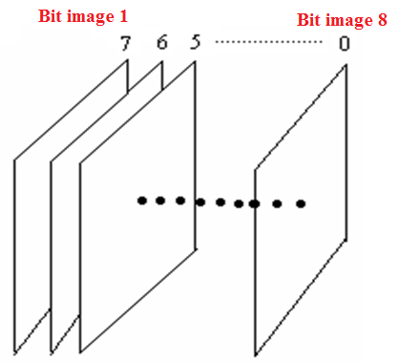
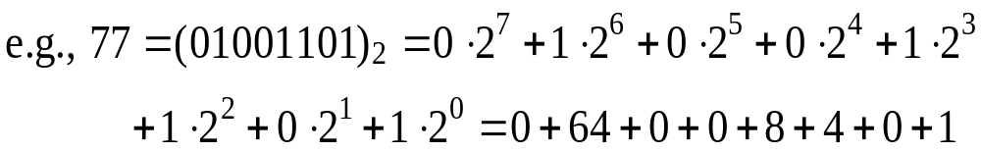
。Grayscale image: 0-255 。Binary image: 0,1
。Bit images
Bit image 1: most
significant bit
plane (i.e., the
7th bit plane)
Bit image 8: least
significant bit
plane (i.e., the
0th bit plane)
3-<number>

Slide 3
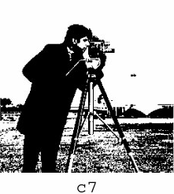
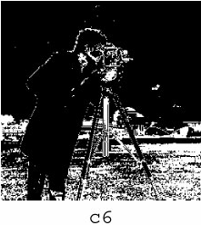
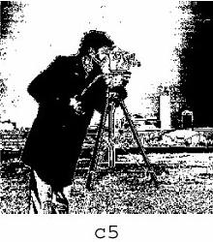
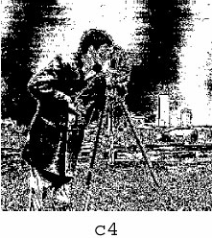
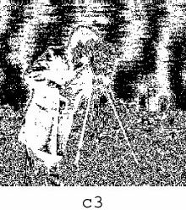
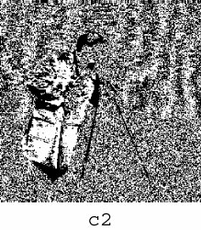
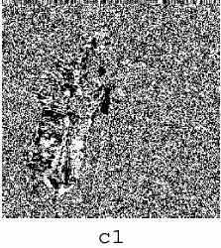
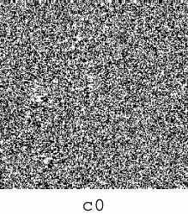
Bit image 1
Bit image 8
3-<number>

Slide 4
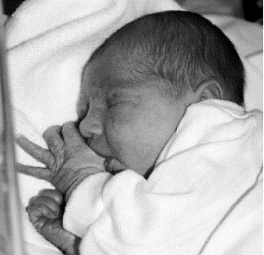
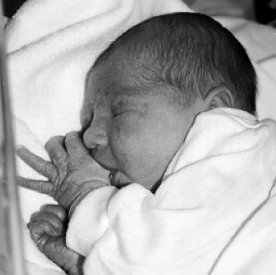
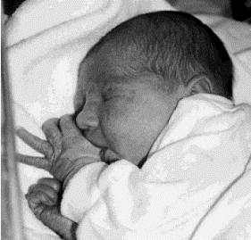
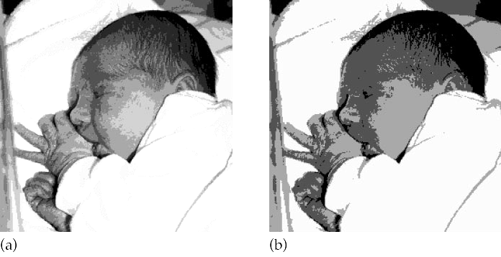
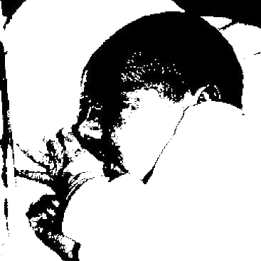
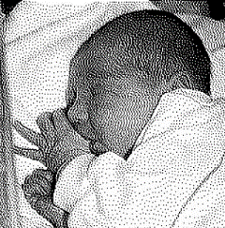
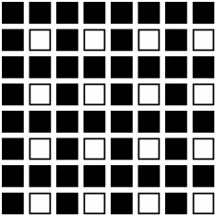
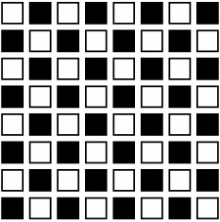
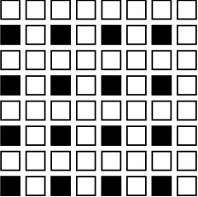
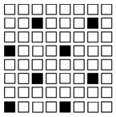
Dithering
-- The process of reducing the number of gray
levels in an image using patterns of dots to
simulate shades of gray
○ Uniform Quantization
False contours
128
64
32
8
4
2
Halftoning –
Represents an
image with 2
tones
3-<number>

Slide 5
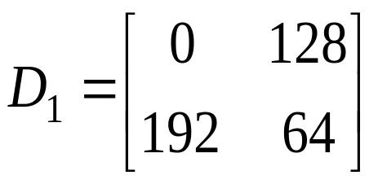

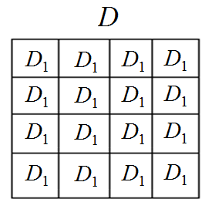
Steps:
Step 1: Construct a dithering matrix
Step 2: Generate dithering array D of image size
by repeating
3-<number>

Slide 6
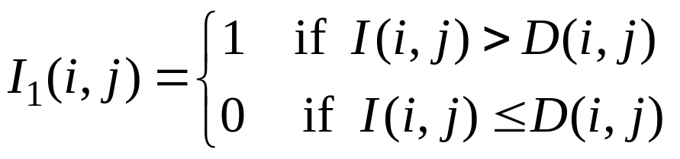

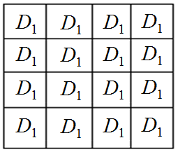
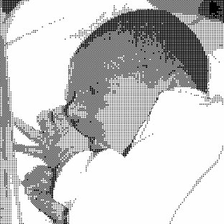

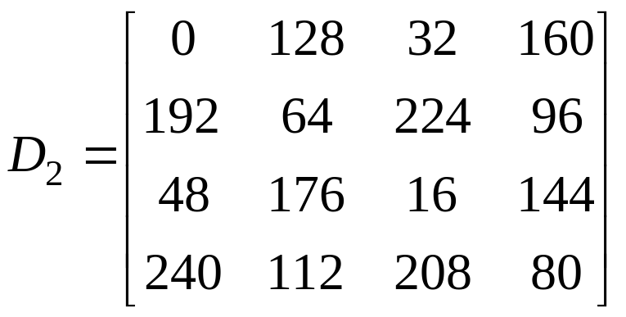
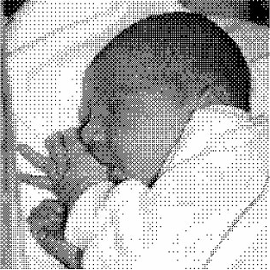

Step 3: Thresholding
I
D
The larger the dithering matrix, the more random in dot scattering
3-<number>

Slide 7
○ Questions:
(a) How to determine the entry values of the
dithering matrix?
(b) How to arrange the positions of entry values?
(c) During extending dithering matrix to dithering
array, how to fit the boundaries of dithering
array and image array?

Slide 8
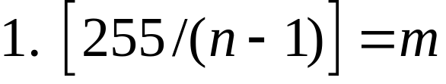
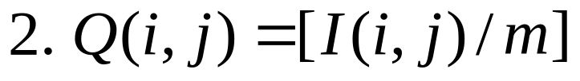

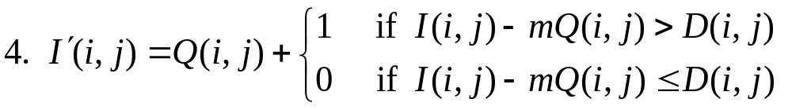
○ Extend to more than two gray values
Let n: the number of output gray values
3. Determine a dithering matrix with its entry
values in the range of [0, m] and extend
to array D
3-<number>

Slide 9


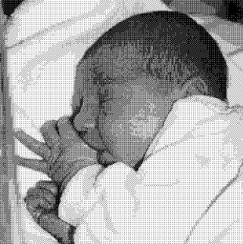
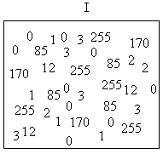
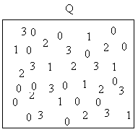
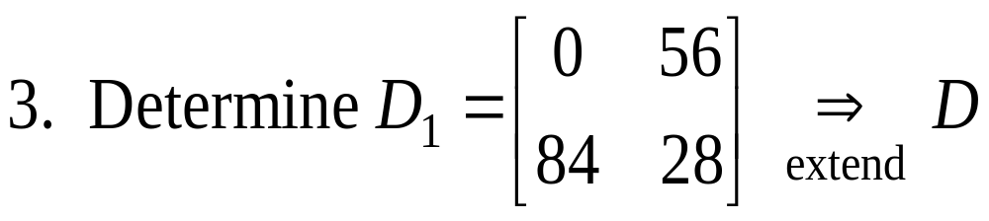
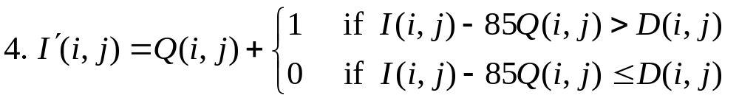
Example 1: 4 output gray values 0, 1, 2, 3
1. 255 / 3 = 85
3-<number>

Slide 10



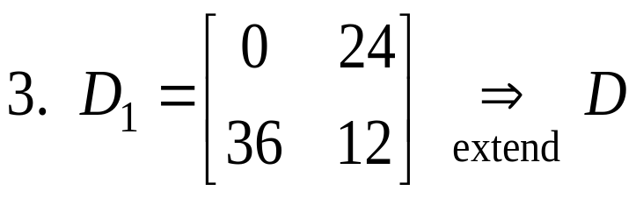
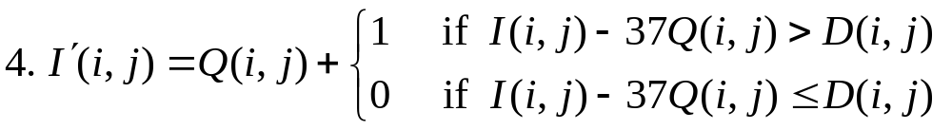
Example 2: 8 output gray values 0, …., 7
1. 255 / 7 = 37
3-<number>

Slide 11

3-<number>

Slide 12

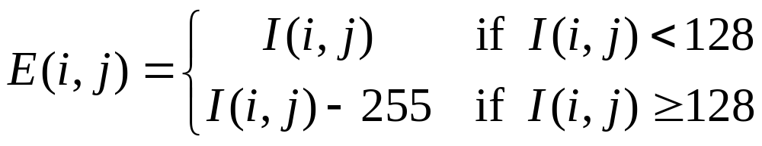
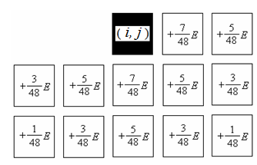
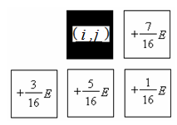

○ Error diffusion dithering
For each pixel ,
1) Calculate quantization error
2) Spread the error according to
Floyd-Steinberg
Jarvis-Judice-Ninke
Let be the cumulated error array.
3-<number>

Slide 13

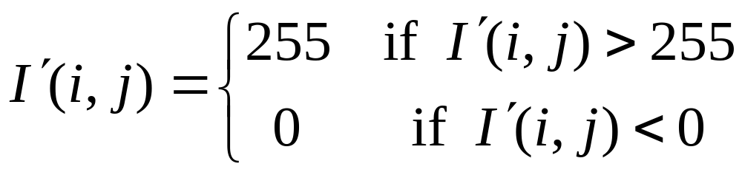

5) Quantize to 0 or 1 using 128 as
the threshold
3-<number>

Slide 14

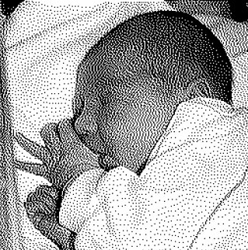
Floyd-Steinberg
Jarvis-Judice-Ninke
3-<number>

